Slide 1
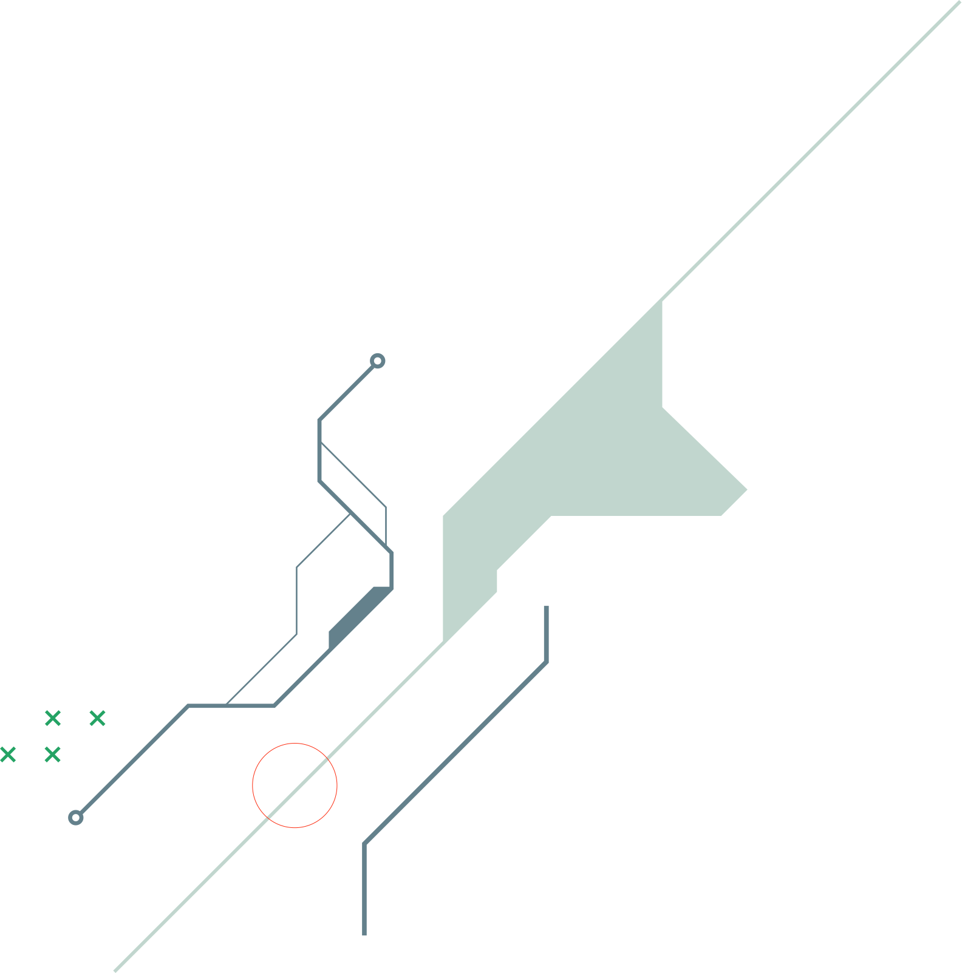
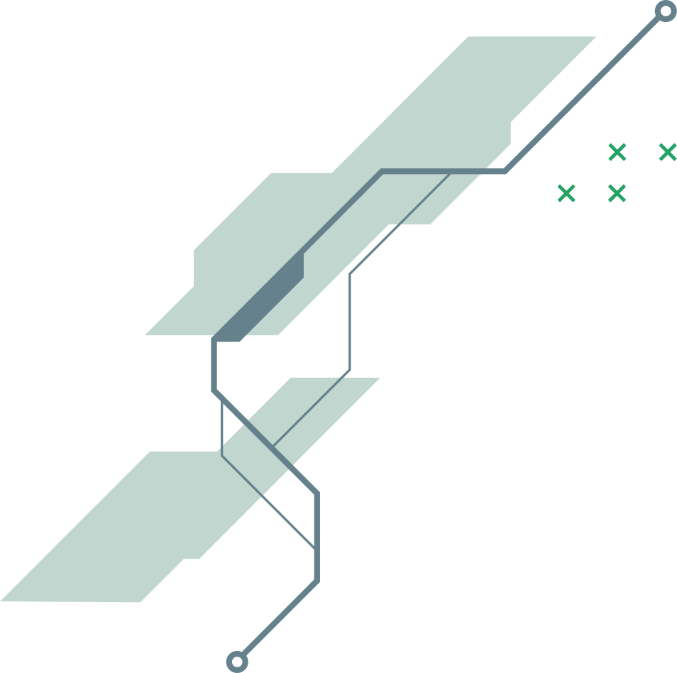

SC2001 Project 3
Dynamic Programming
Group 3
Gao Xin Yue U2322378A
Tio Sher Min U2320324H
Lee Pei Xin U2320668K

Slide 2
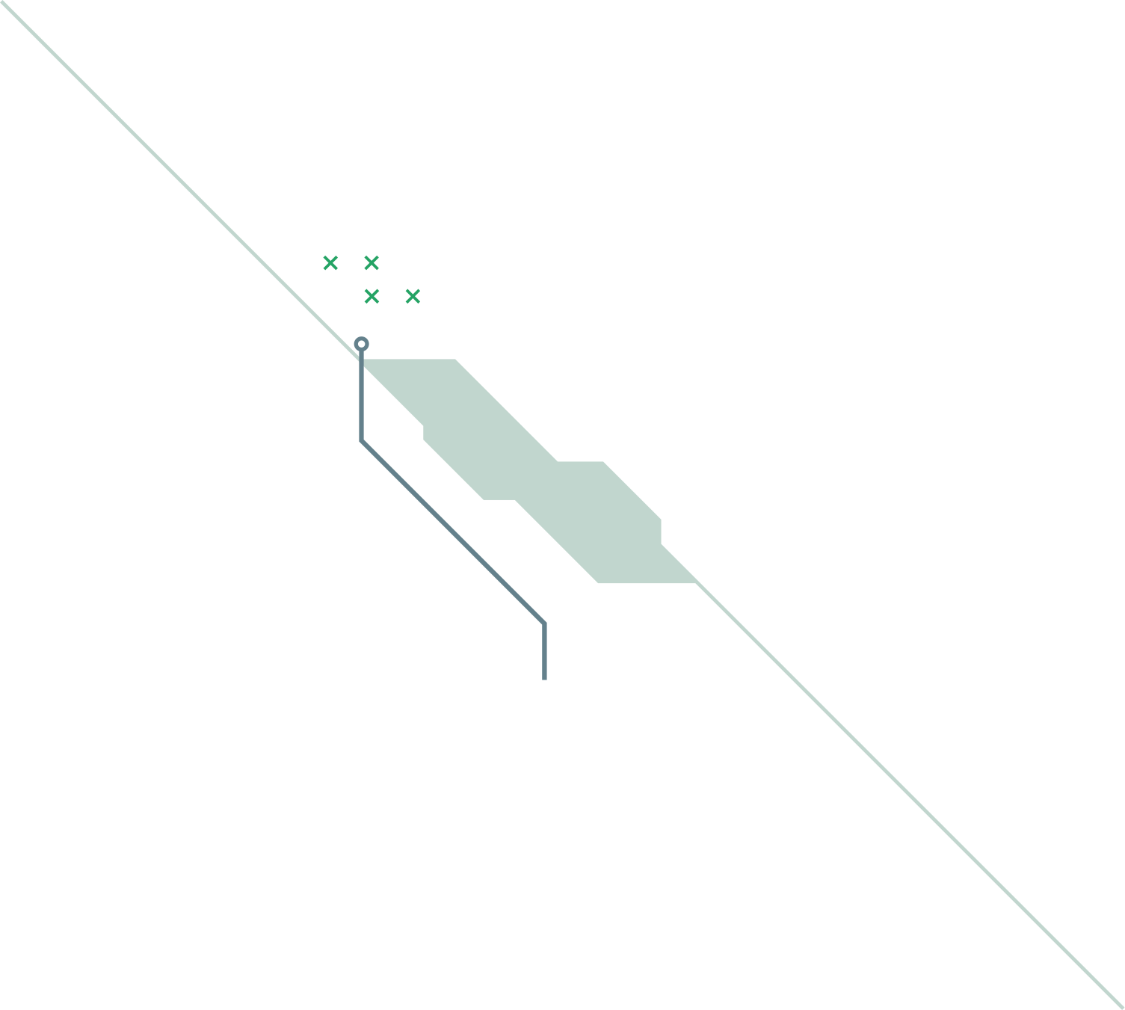
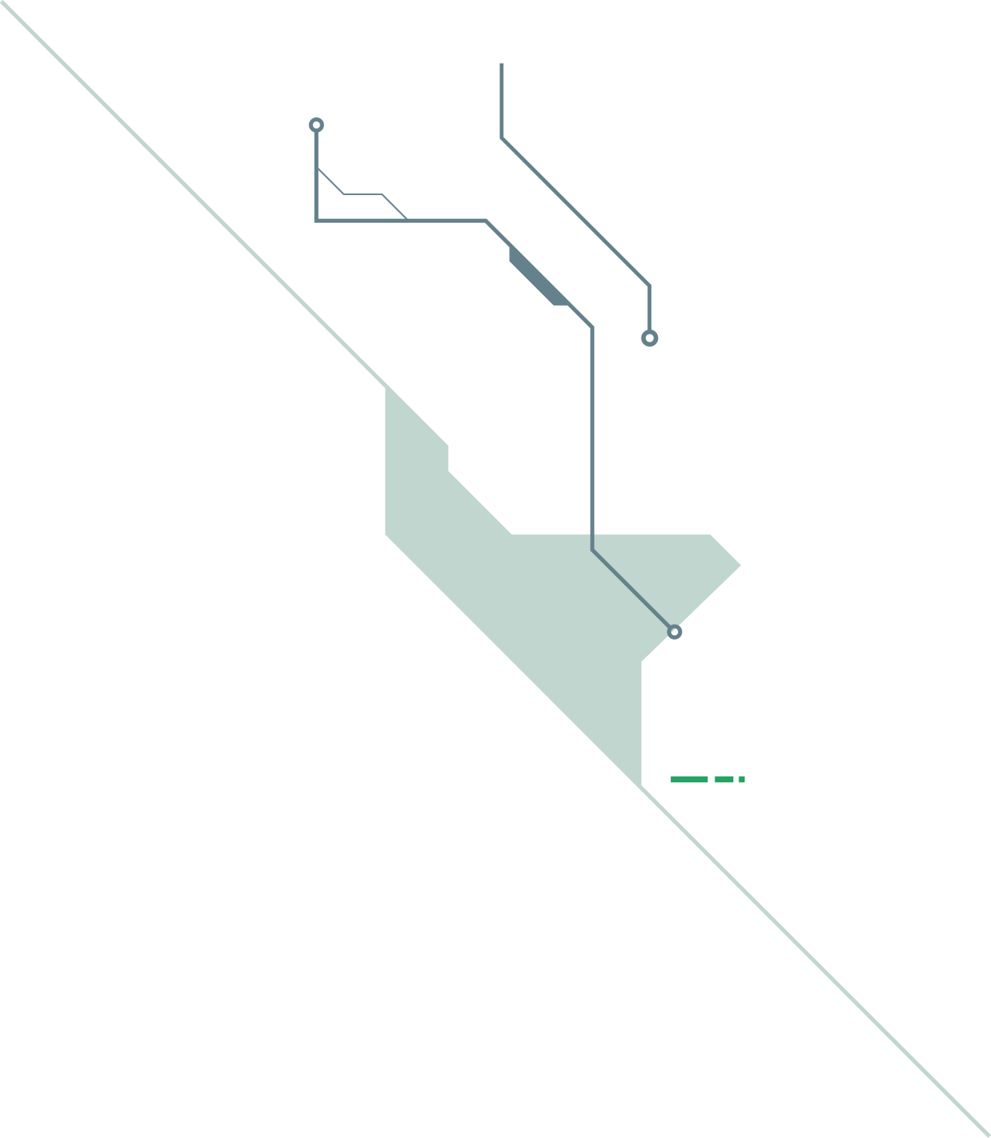
TABLE OF CONTENTS
01
02
Recursive definition
Subproblem graph of P(14)
03
04
Dynamic Programming
Compare P(14) with different weights

Slide 3
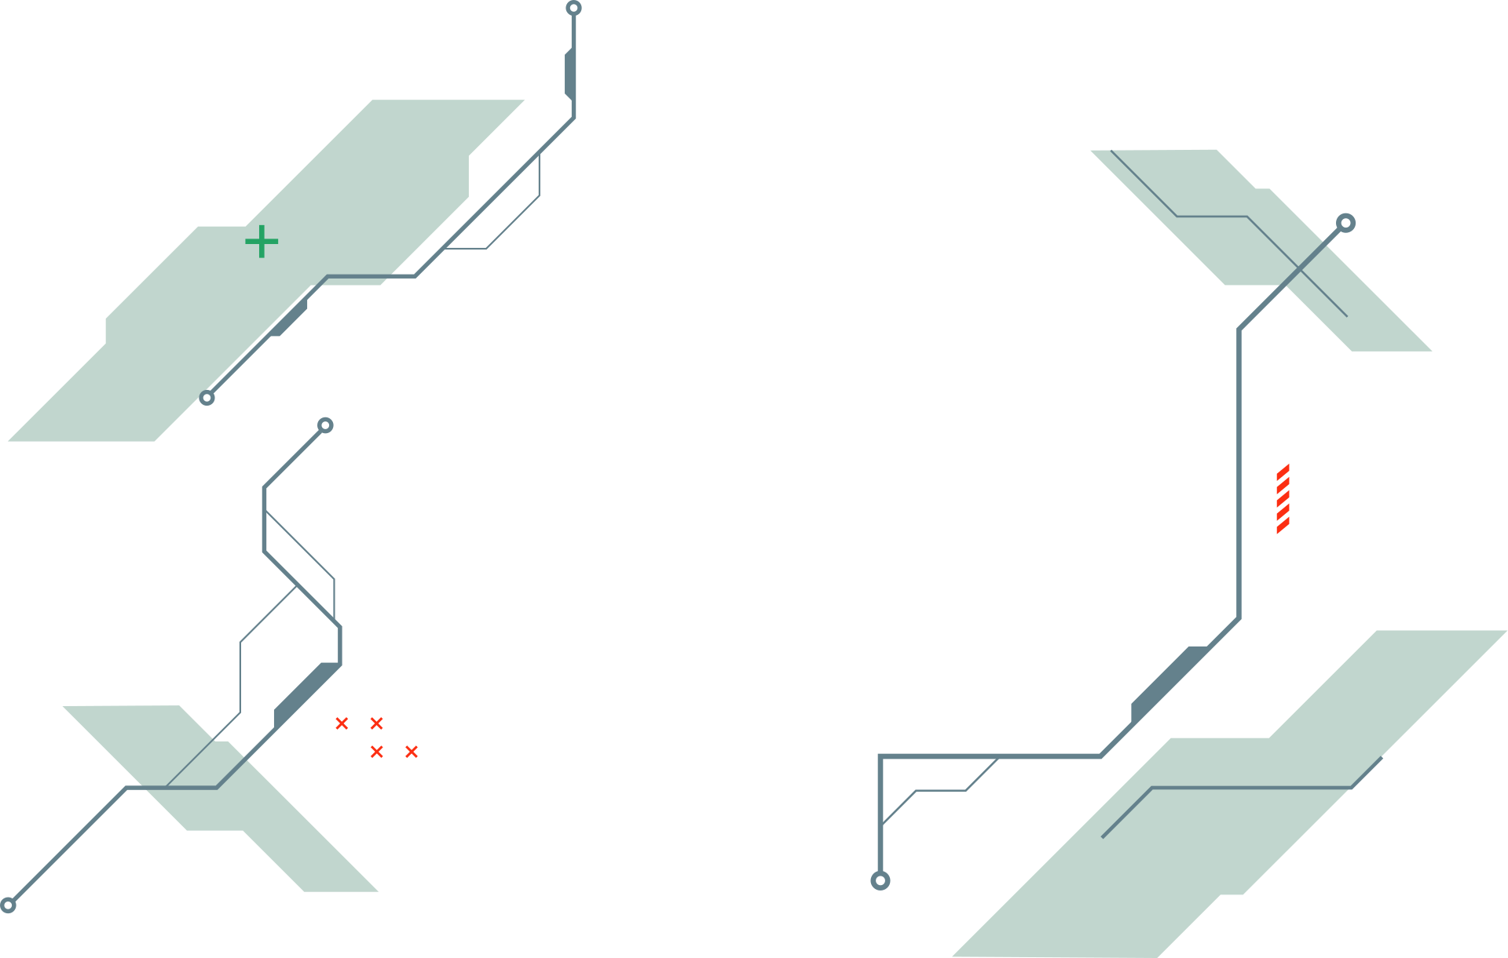
01
Recursive definition

Slide 4
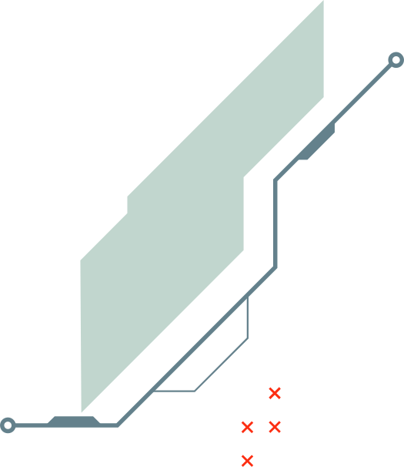
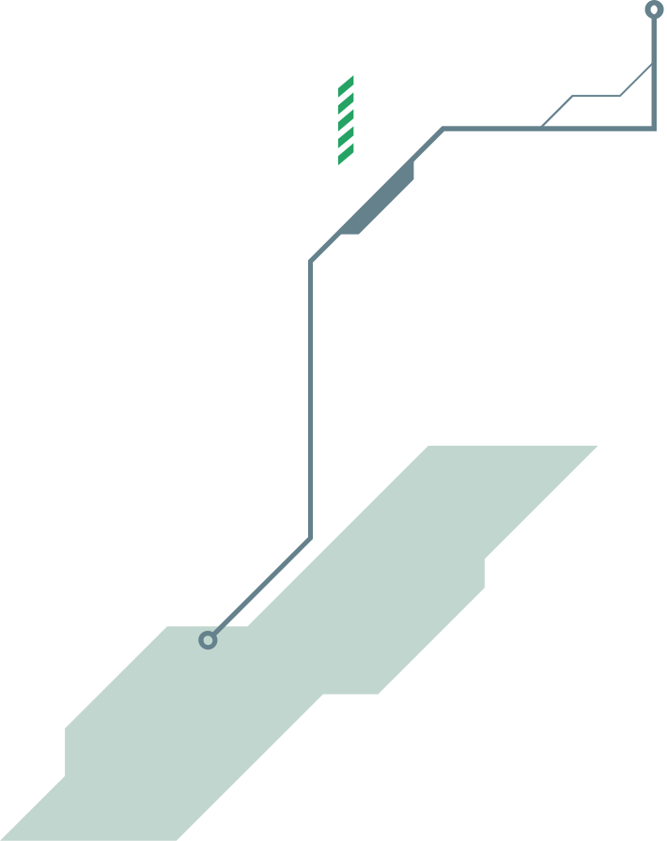
Recursive Definition of P(C)
C: capacity
i = 0, 1, ... , n-1
Base Case:
P(C)= 0 when C=0 or n=0
P(C) = max( P(C), P(C-w ) + p )
i
i
ith item is excluded
ith item is included
Notes:
1) base case:
- capacity = 0 or if no items to choose from
- maximum profit = 0
2) formula:
- recursive approach to maximise profit using 2 options: include/exclude ith item in knapsack
3) exclude (red)
- get profit without ith item
4) include (green)
- include ith item + add its profit
- reduce remaining C-w[i]
- get profit with ith item
5) take max of the 2 to get highest profit

Slide 5
02
Subproblem graph of P(14)

Slide 6
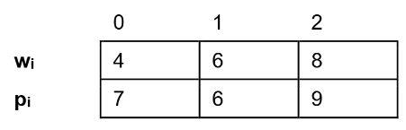
P(14)
P(10)+7
P(6)+9
P(6)+7+7
P(2)+7+9
P(4)+7+6
P(8)+6
P(2)+9+7
P(0)+9+6
P(0)+7+6+7
P(4)+6+7
P(0)+6+9
P(2)+7+7+7
P(2)+6+6
P(0)+7+7+6
Maximum Profit: 7+7+7 = 21

Slide 7
03
Dynamic Programming

Slide 8
Dynamic Programming with Bottom-Up Approach:
2D DP Array: dp[i][j] stores the maximum profit for capacity j using items up to index i.
Initialize DP Array: Each row represents an item and each column represents a capacity from 0 to C.
Outer Loop:
iterates over each capacity j from 1 to C.
4.Inner Loop:
iterates over each item i.
Excluding the item: If we exclude the item, dp[i][capacity] is set to dp[i - 1][capacity] if i > 0, otherwise it’s 0 (base case).
Including the item: If weights[i] <= capacity, the code calculates the profit by including the item, allowing reuse by taking dp[i][capacity - weights[i]] + profits[i].
5. Final Solution:
dp[n-1][C] holds the maximum profit for capacity C using all items.

Slide 9
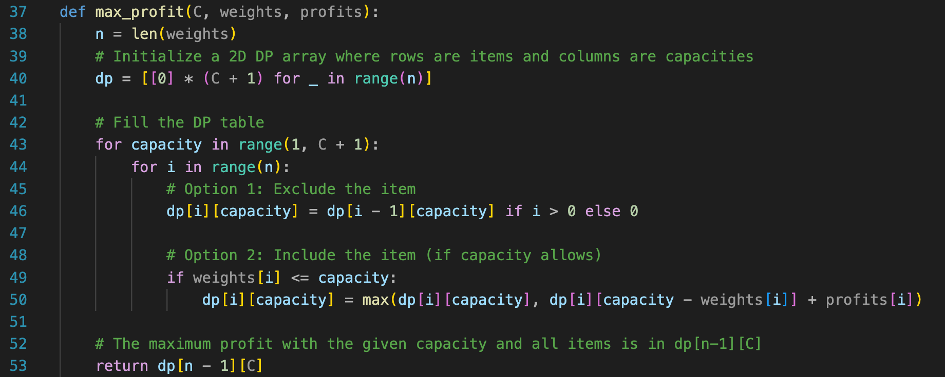
Dynamic Programming with Bottom-Up Approach:
The code allows item reuse by repeatedly updating dp[i][capacity] with dp[i][capacity- weights[i]] + profits[i] whenever an item fits.

Slide 10
Time Complexity
Outer Loop (Capacities):
The outer loop iterates over each capacity from 1 to C, so it runs C times.
Inner Loop (Items):
For each capacity, the inner loop iterates over all n items.
In Each Iteration:
Within the inner loop, the program checks two options (excluding and including the item) and performs a constant-time update of the dp array.
Overall Time Complexity:
Since the outer loop runs C times and the inner loop runs n times for each capacity, the total time complexity is: O(n×C)

Slide 11
Space Complexity
DP Array:
The 2D dp array has n rows (one for each item) and C + 1 columns (one for each capacity from 0 to C), resulting in a space complexity of: O(n×C)

Slide 12
vs Recursive Solution (Without Memoization)
try each item at every capacity level, making recursive calls for each item that can fit within the remaining capacity.
The recursion continues until the remaining capacity is exhausted (or until there are no items left to consider).
Time Complexity
For each capacity C, we have n choices (one for each item) if it fits. For each choice, the function calls itself recursively with a smaller capacity (C - weight[i]).
Branching Factor: At each step, the function can branch out n times (one for each item), and it can potentially reach down to a depth of C (if each call reduces capacity by 1 in the worst case).
Worst-Case Time Complexity:O(n^C), which is exponential.
Space Complexity
Recursive Call Stack: The depth of the recursive calls depends on the capacity C.
worst case: each call reduces the capacity by the smallest weight, leading to a maximum depth of C.
-> O(C)

Slide 13
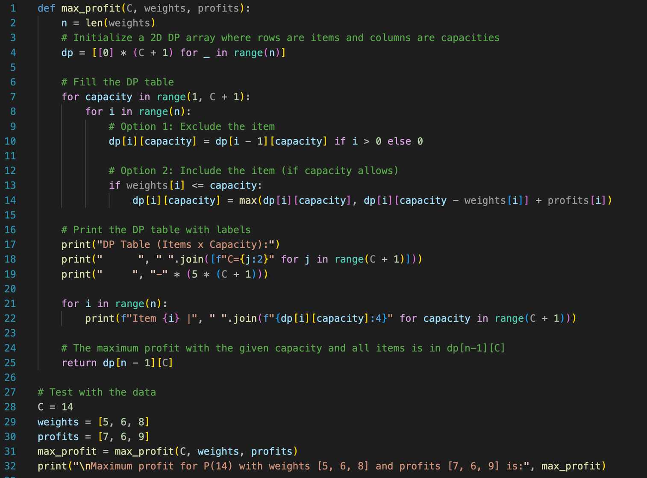
Code for running the DP algo and printing part 4 results

Slide 14
04
Results using Dynamic Programming

Slide 15
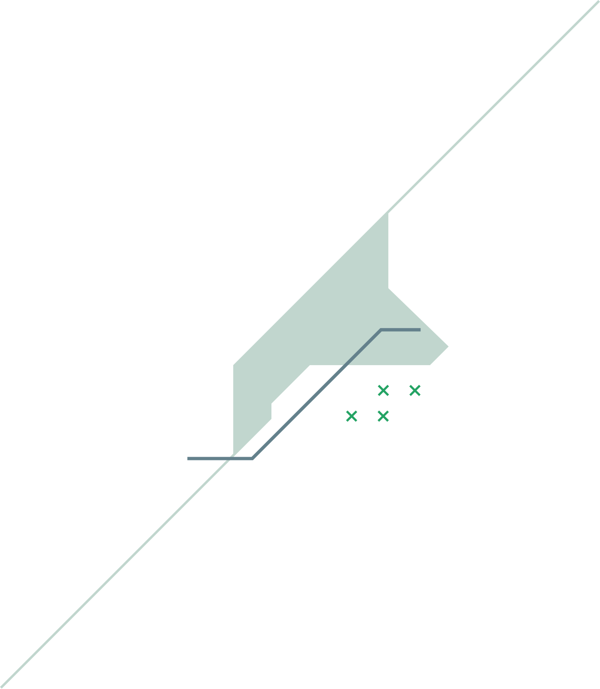
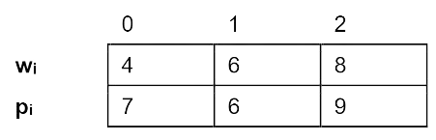
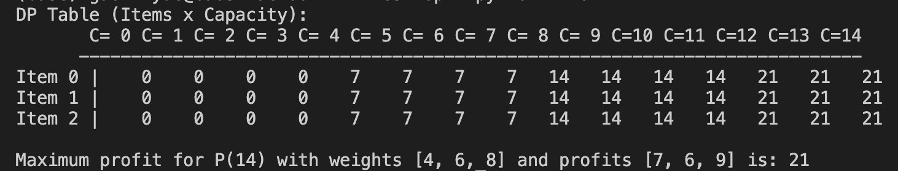
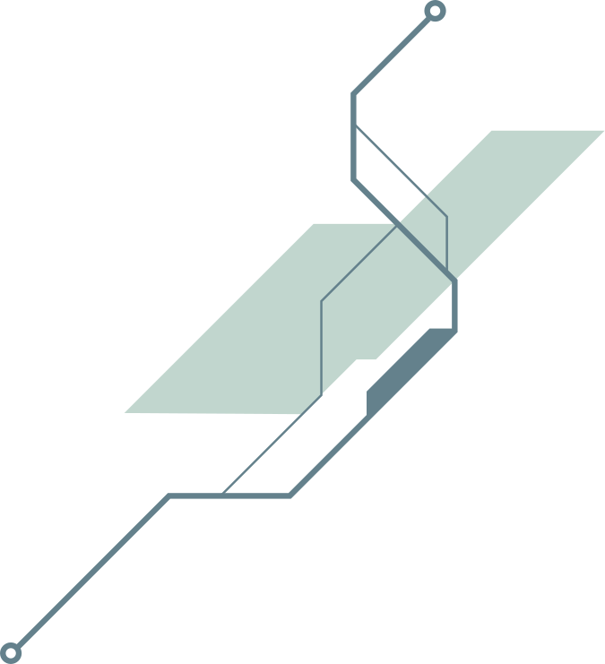
4(a) Results of P(14) with
Maximum Profit = 21

Slide 16
4(a) Results of P(14) with
Maximum Profit = 21
at C=4, item 0
will be placed in the bag
bag = [0]

Slide 17
4(a) Results of P(14) with
Maximum Profit = 21
at C=8, another item 0
will be placed in the bag
bag = [0,0]

Slide 18
4(a) Results of P(14) with
Maximum Profit = 21
at C=10,
if we consider including item 1
bag = [0,0]: profit = 7+7=14
bag = [0,1]: profit = 7+6=13<14

Slide 19
4(a) Results of P(14) with
Maximum Profit = 21
at C=12, another item 0
will be placed in the bag
bag = [0,0, 0]

Slide 20
4(a) Results of P(14) with
Maximum Profit = 21
at C=12,
if we consider including item 2
bag = [0,0, 0]: profit = 7+7+7=21
bag = [0,2]: profit = 7+9=15<21

Slide 21
4(a) Results of P(14) with
Maximum Profit = 21

Slide 22
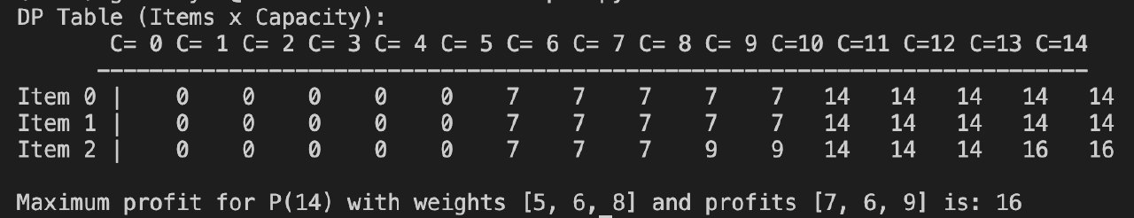
4(b)Results of P(14) with
Maximum Profit = 16

Slide 23
4(b)Results of P(14) with
Maximum Profit = 16
at C=5, item 0
will be placed in the bag
bag = [0]

Slide 24
4(b)Results of P(14) with
at C=8, only item 0
is in the bag
bag = [0]
at C=8,
consider up till item 2
bag = [0] --> 7
bag = [2] --> 9>7
Maximum Profit = 16

Slide 25
4(b)Results of P(14) with
at C=10,
consider up till item 2
bag = [0, 0] --> 7+7=14
bag = [2] --> 9<14
Maximum Profit = 16
at C=10, another item 0
is added to the bag
bag = [0, 0] --> 7+7=14

Slide 26
4(b)Results of P(14) with
at C=11,
consider item 1
bag = [0, 0] --> 7+7=14
bag = [0,1] --> 7 + 6 = 13<14
Maximum Profit = 16

Slide 27
4(b)Results of P(14) with
Maximum Profit = 16
at C=13,
consider up till item 2
bag = [0, 0] --> 7+7=14
bag = [2, 0] --> 9 + 7 = 16 > 14
at C=13, another item 0
is added to the bag
bag = [0, 0] --> 7+7=14

Slide 28
4(b)Results of P(14) with
Maximum Profit = 16

Slide 29
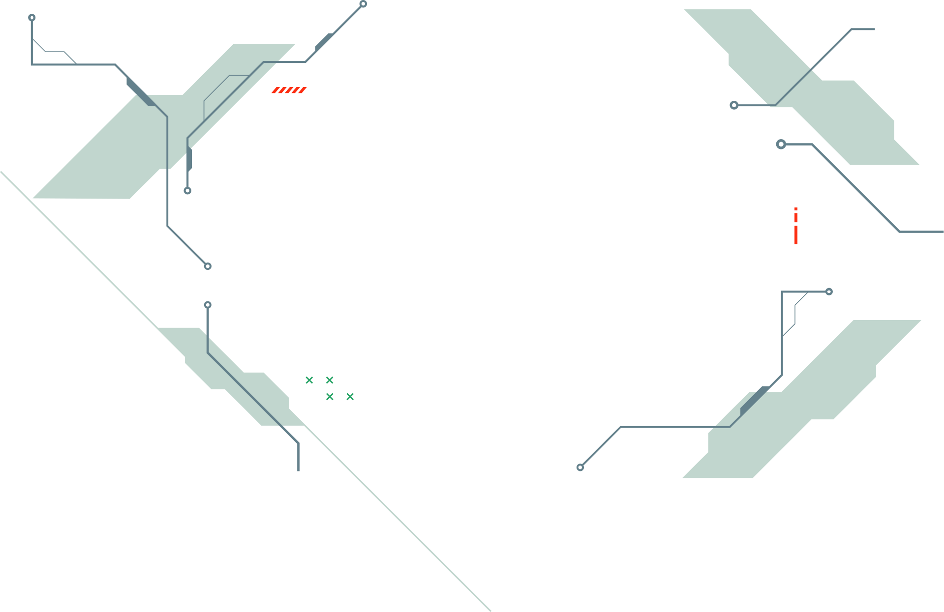
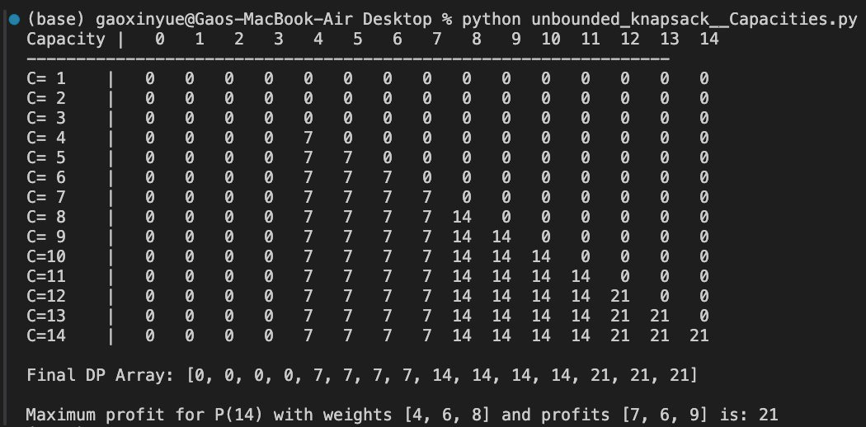
Conclusion
Dynamic Programming improved the overall efficiency
time complexity (DP): O(Cn) vs time complexity(recursive function): O(n^C)
space complexity (DP): O(Cn) using 2D array
to further improve the programming,
we can implement the 1D array, we can improve the space complexity to O(C) but it decreases the readability.
using 2D array
using 1D array

Slide 30
THANK YOU

